Slide 1
Project Kickoff Meeting
Date: 9 Dec 2024

Slide 2
Agenda
Introduce Team
Our Understanding
High-Level Project Plan
Communication Plan
Escalation Matrix
Pre-requisites and Next steps

Slide 3
Introduce Team

Slide 4
Introduction
Introduction
Account Management
Sandeep Shahapurkar
Sr Director-Cloud Consulting
Mukesh Rawlani
Sr Cloud Consultant
Project Team - Searce
Dipali Kale
Project Manager
Nagababu Medicharla
Principal Cloud Architect
Karan Chandwani
Cloud Engineer
Shivanshu Sharma
Cloud Engineer

Slide 5
Our Understanding

Slide 6
Our Collective Mission
Our goal is to work with Rubiscape to achieve our shared vision of:
Rapid Expansion by deploying the product on AWS marketplace
Azure & On-Premises to AWS Migration.
CloudFormation & Helm charts for Infrastructure Deployment

Slide 7
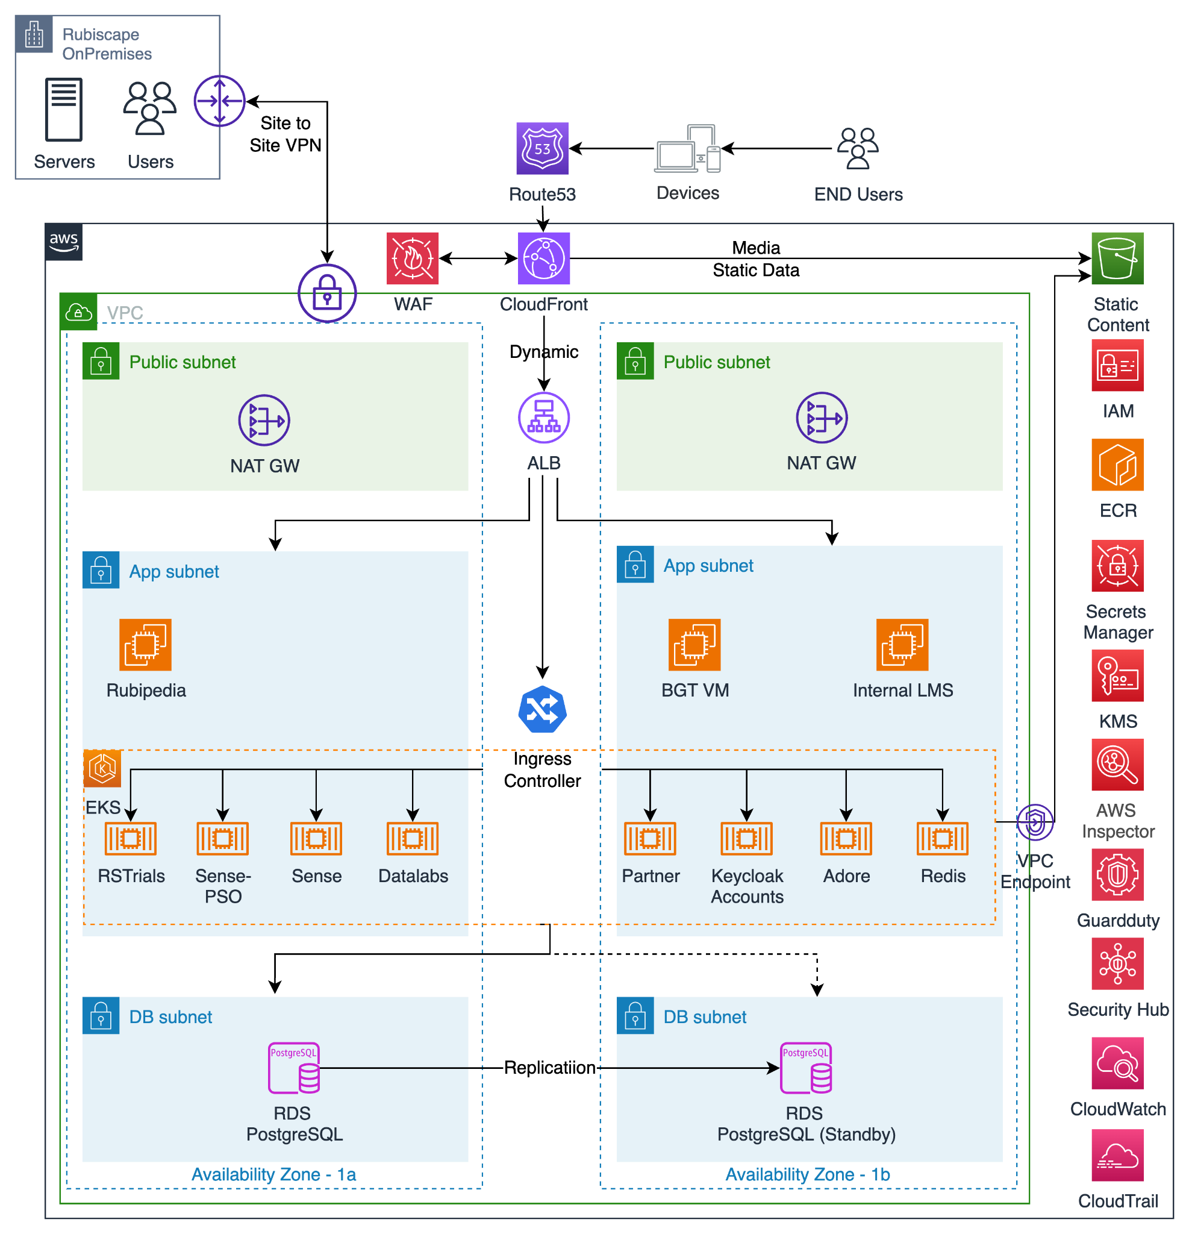
High-level future state architecture
India Region

Slide 8
High-level Project Plan

Slide 9
High-level Project Plan
Sr No | Milestone | W0 13 Dec | W1 20 Dec | W2 30 Dec | W3 6 Jan | W4 13 Jan | W5 20 Jan | W6 27 Jan | W7 3 Feb | W8 10 Feb | W9 17 Feb | W10 24 Feb | W11 3 Mar
1 | Discovery
2 | Configure Networking, IAM and EC2 instance provisioning
3 | Setup EKS cluster, Creation of deployment files
4 | Setup Jenkins on EKS, Setup CI/CD pipeline
5 | Migrate the local data to S3 and PostgreSQL DB to AWS RDS
6 | Create Cloudfront, Application Testing
7 | Setup Monitoring, logging and backup and cutover
8 | KT and Handover of the Migration Completed
9 | Quick Launch Setup and Testing
10 | Prerequisites for Marketplace Listing
11 | Marketplace Listing
12 | Project Closure and Sign off

Slide 10
Deliverables and Success - App Deployment
Deliverable | Success Criteria | Est. Delivery Date
Configure Networking, IAM and EC2 instance provisioning | Create IAM users, Create VPC, subnets, security groups and EC2 instances in prod and Dev region and handover to Rubiscape team | 23 Dec 2024
Creation of deployment files and EKS cluster | Create EKS cluster and manifest files for 9 microservices | 6 Jan 2025
Setup Jenkins on EKS, Setup CI/CD pipeline | Create Jenkins Server on EKS Cluster Use Jenkins to build the Docker Image and push the image to Repositories | 11 Jan 2025
Migrate the local data to S3 and PostgreSQL DB to AWS RDS | Provision RDS PostgreSQL DB in Prod Env, Export Full backup of PostgreSQL DB and Restore to AWS RDS PostgreSQL DB, Migrate the Static Data from Local Disks On premises to AWS S3 buckets over AWS CLI | 17 Jan 2025
Create Cloudfront, Application Testing | Create CloudFront Distribution for Content Delivery, Create Origins for the S3 buckets and Application servers, End to end application testing by Rubiscape team | 21 Jan 2025
Setup Monitoring, logging and backup and cutover | Provision Logging using Grafana Loki, Schedule Backup Plans to take manual snapshots of the EBS Volumes and RDS PostgreSQL Database and plan cutover | 7 Feb 2025
KT and Handover for the Deployment | End to end testing, validation, KT and handover to Rubiscape team | 7 Feb 2025

Slide 11
Deliverables and Success - Marketplace Listing
Deliverable | Success Criteria | Est. Delivery Date
Quick Launch Setup and Testing | Create cloudformation template for marketplace listing for infra creation and application deployment | 22 Jan 2024
KT of the Cloud Formation template | Searce team will provide the KT on cloudformation template | 24 Jan 2024
Prerequisites for Marketplace Listing | Rubiscape team to complete the pre-req needed for marketplace listing | 24 Jan 2024
Marketplace Listing | Enable Quick Launch on AWS Marketplace to enable users to create the Application environment including EKS Cluster with AWS CloudFormation Stack and Deploy the applications to the cluster using Helm chart | 19 Feb 2025
Project Closure and Sign off | Project closure activities - Documentation and sign off on the project | 28 Feb 2025

Slide 12
Communication Plan

Slide 13
Communication Plan
Meeting | Cadence | Purpose | Attendees
Daily Stand-up | Daily | Raise blockers, completed tasks, and updated queue | Consultants, SCEs, Partners, Project Managers
Weekly project status meeting | Weekly | Track weekly progress on deliverables, highlight risks, and provide update on action items | Leadership, Consultants, SCEs, Partners, Project Managers
Deep-dive sessions | 3x/week | Collaborate to capture design requirements and create solutions related to specific architecture topics | Team Leads, Leadership, Consultants, SCEs, Partners
Midpoint leadership update | Monthly | Executive summary providing updates to Project Sponsors and Executive Team on progress of project | Executive Leadership, Project Managers, Program Managers
Cloud plan wrap-up session | Once | Summary of engagement, infrastructure, and application architecture design reviews, and project plan and deployment support review for foundational requirements | Executive Leadership, Project Managers, Program Managers

Slide 14
Cadence Meeting Types and Purpose
Meeting | Cadence Call | Weekly Cadence Call
Time | Daily at 11.00 am | On Tuesday at 11.00 am
Participants | Searce Core Project Team Project Management Rubiscape Program Management Core Project Team | Searce Core Project Team Project Management Rubiscape Execs Program Management Core Project Team AWS Team
Purpose | Review of tasks’ progress Internal and external dependencies Escalation of issues & blockers | Review of weekly project status Weekly presentation / demo

Slide 15
Cadence Call format
Each team has to answer below questions:-
What was done yesterday?
What will we do today?
Any roadblocks & dependencies?
Additional discussed points
Setup ad-hoc meeting between team if required

Slide 16
Tools
Slack/Google Chat - Daily Collaboration
Email - Summaries & Status
Google Meet - Calls & Meetings
Google docs & sheets - Documentation, Status Reports
Gitlab – Code repository & functional documentation
ClickUp - Project Management Tool

Slide 17
Resolution Procedures
Type | Description | Patch to resolution
Risks | Highlights a possible source of delay in the delivery of a milestone | Submitted through RAID Log and discussed during weekly project status meetings if inter-team closure is unsuccessful
Action items | Covers an assigned task that must have a clear owner and due date
Issues | Describes a concern that may not yield in any specific project delay
Dependencies | Explains which activities must be completed (including who must complete them) in order for progress to be made on a given milestone
Change requests | Articulates a need to alter an agreed-upon program deliverable (expectation differs from original design) and must be assessed for program-wide impact | Submitted through CR Log and discussed during weekly project status meetings if inter-team closure is unsuccessful. Requires executive leadership approval and a new SOW to be signed

Slide 18
Escalation Matrix

Slide 19
Escalation Matrix | Searce
Escalation Level | Name | Designation | Email ID
1 | Dipali Kale | Sr Project Manager | dipali.kale@searce.com
2 | Neha Dave | Program Manager | neha.dave@searce.com
3 | Nagababu M | Delivery Manager | nagababu.medicharla@searce.com

Slide 20
Escalation Matrix | Rubiscape
Escalation Level | Name | Designation | Email ID
1 | Swanand Kulkarni | Chief Procurement Officer | swanand.kulkarni@rubiscape.com
2

Slide 21
Pre-requisites and Next steps

Slide 22
Pre-requisites
Rubiscape
Provide AWS Admin Access to Searce team
Provide non overlapping VPC CIDR Ranges [Both for Mumbai and Sydney region]
Searce
Create Communication Channel
Create Project Plan

Slide 23
Solving for better

